Slide 1
History Variables
——Auxiliary Variables in TLA+：Ch3
Ruize Tang
14/9/2018

Slide 2
In the last seminar…
Specification MinMax1 and MinMax2
Both specs continuously accept user input and response one value of {Hi, Lo, Both, None}.
Both use a variable x to hold the input or response, and turn to indicate whether it’s the user’s or server’s turn.
MinMax1 uses a variable y to hold all the user input while MinMax2 only records the min and max input value.

Slide 3
In the last seminar…(cont.)
Refinement in General
Let x denote x1 , . . . , xm. y and z are the same.
Consider x to be externally visible variables and y and z to be internal variables.
To verify that ∃y : Spec1 implements ∃z : Spec2
However, sometimes there doesn’t exist a refinement mapping under which Spec1 implements Spec2.
In most cases, we can construct the necessary refinement mapping by adding auxiliary variables to Spec1 .
History variables is one kind of the three variables.

Slide 4
Equivalence of MinMax1 and MinMax2
We observed that ∃y : Spec1 and ∃min, max : Spec2 are equivalent (each implies the other).
We found a refinement mapping under which Spec1 implements Spec2.
But how to prove the converse implication?
We know that y holds the input set in Spec1, while Spec2 only saves the min and max. So there is no way to reconstruct the input set of MinMax2.

Slide 5
Equivalence of MinMax1 and MinMax2 (cont.)
Adding auxiliary variable a to Spec1 means finding Spec1ª such that ∃a: Spec1ª is equivalent to Spec1.
Showing that ∃y, a : Spec1 a implements ∃z : Spec2 shows that ∃y : Spec1 implements ∃z : Spec2.

Slide 6
Equivalence of MinMax1 and MinMax2 (cont.)
We write a new spec such that ∃h : Spec2^{h}.
h records previous values of the x , but does not affect the current or future values of x or any other variables of Spec2 .
We call h a history variable.

Slide 7
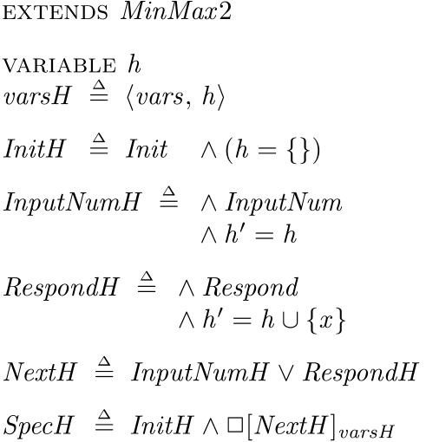

Equivalence of MinMax1 and MinMax2 (cont.)
Therefore, Spec2^{h} implements Spec1 under the refinement mapping y ← h

Slide 8
Disjunctive Representation
We have add a history variable h by conjoining h = exp_{Init} to its initial predicate and h’ = exp_{A} to each subaction A of its next-state action.
To make this precise, we have to state exactly what a subaction is.
In module MinMax2H, we took InputNum and Respond to be the subactions.

Slide 9
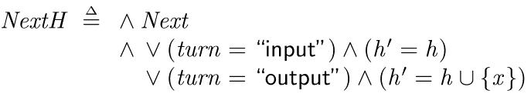
Disjunctive Representation(cont.)
However, we can also consider Next itself to be a subaction of Next.

Slide 10

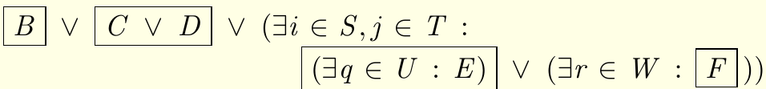
Disjunctive Representation(cont.)
A disjunctive representation of a formula N is a way of writing N in terms of subactions A1 , . . . , Am using only the operators ∨ and ∃k ∈ K , for some identifiers k and expressions K .

Slide 11
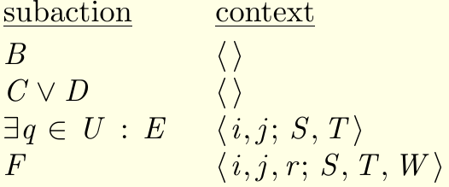
Disjunctive Representation(cont.)
Context: <k; K>, lower k is an n-tuple of identifiers and upper K is an n-tuple of expressions.
If <k; K> is the empty context <;>, we let ∃<k; K> : F and ∀<k; K> : F equal F .

Slide 12
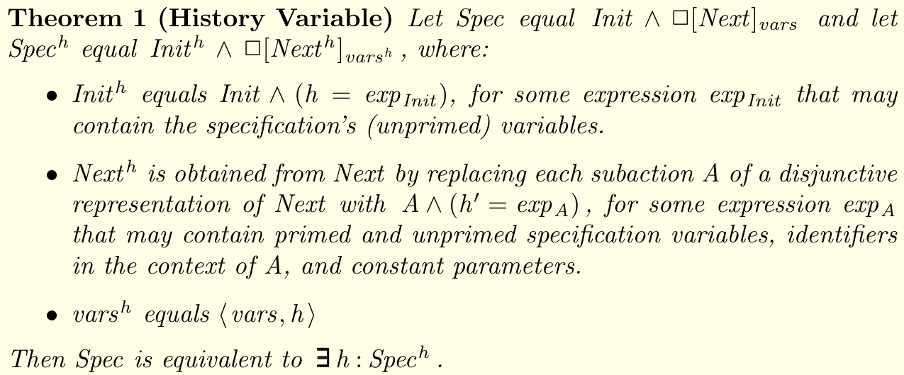
Disjunctive Representation(cont.)

Slide 13

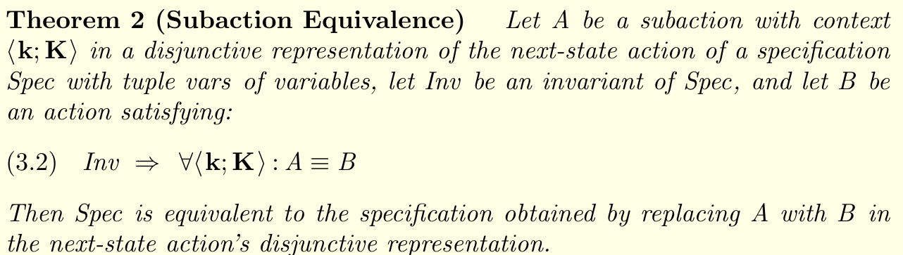
Equivalence of Next-State Actions

Slide 14
Discussion of History Variables
In practice, we just want to show that spec S satisfied some property P instead of proving they are equivalent.
We often want to show S implies a more abstract spec T. The standard way is to find a refinement mapping.
When the high-level T remembers its state info while that is forgotten by S, we can add history variables to S.

Slide 15
Discussion of History Variables(cont.)
Some people think T is not a good high-level spec because it keeps past info that its implementation S doesn’t have to.
However, sometimes this can be simpler.
We may also add history variables even if we aren’t explicitly construct refinement mapping. For example, spec S requires one kind of action happen before another. We can add a history variable to save all behaviors.
Because of it is history variables, it doesn’t need to be implemented in the real system.

Slide 16
Liveness
A natural liveness spec is that every input should produce an output.
This can be done by conjoining WF_vars(Respond) to Spec, we call the new spec Lspec.
The way to verify spec1 => spec2 is the same as before. But spec2 => spec1 should introduce history variables.

Slide 17

Liveness
If the spec is written in canonical form:
Then, add history variables can be written:
But that is weird because Respond is not the a subaction of NextH.

Slide 18


